Slide 1


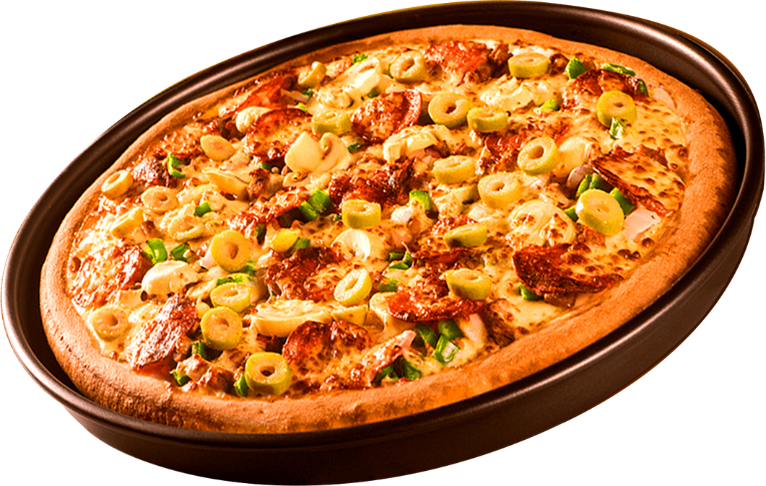
SQL DATA ANALYSIS ON PIZZA
Start Your Slide
ORDER
NOW

Slide 2
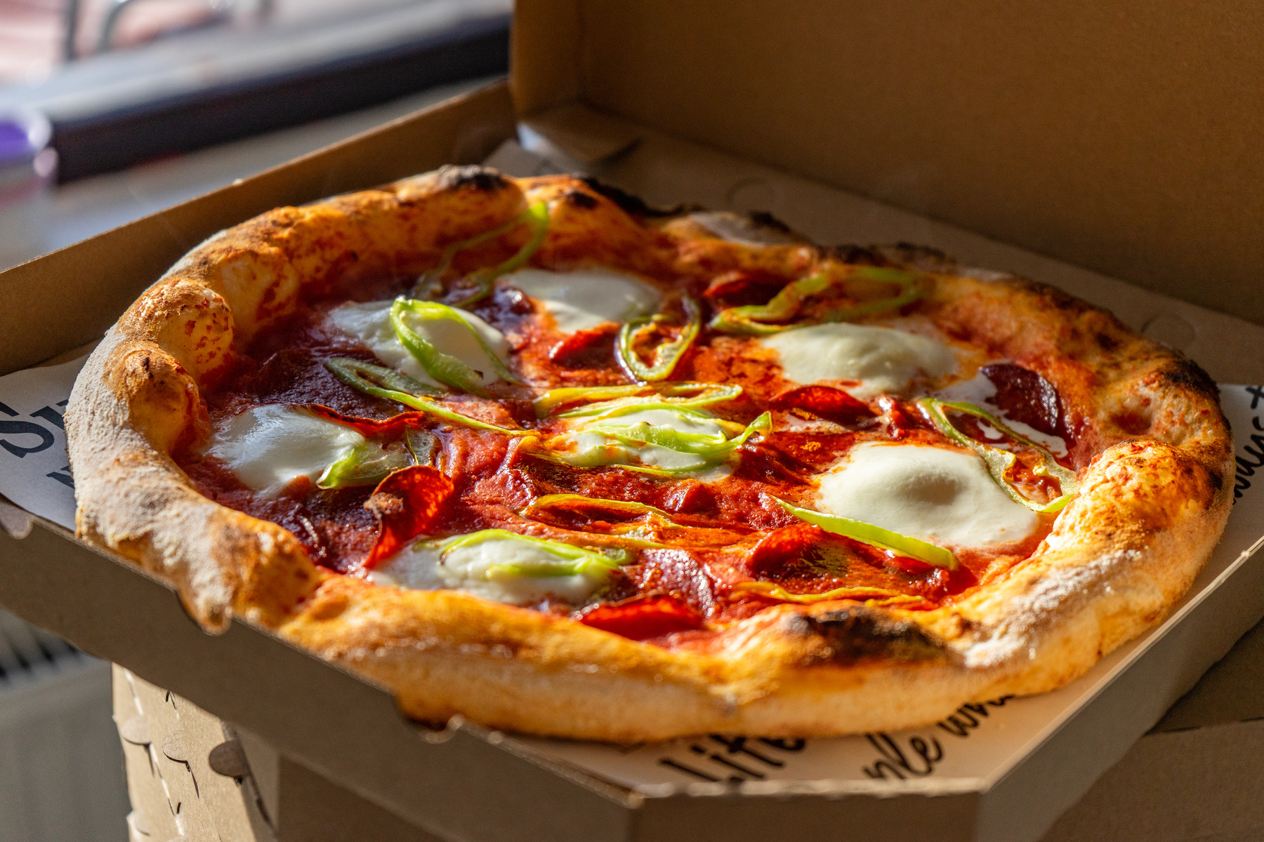
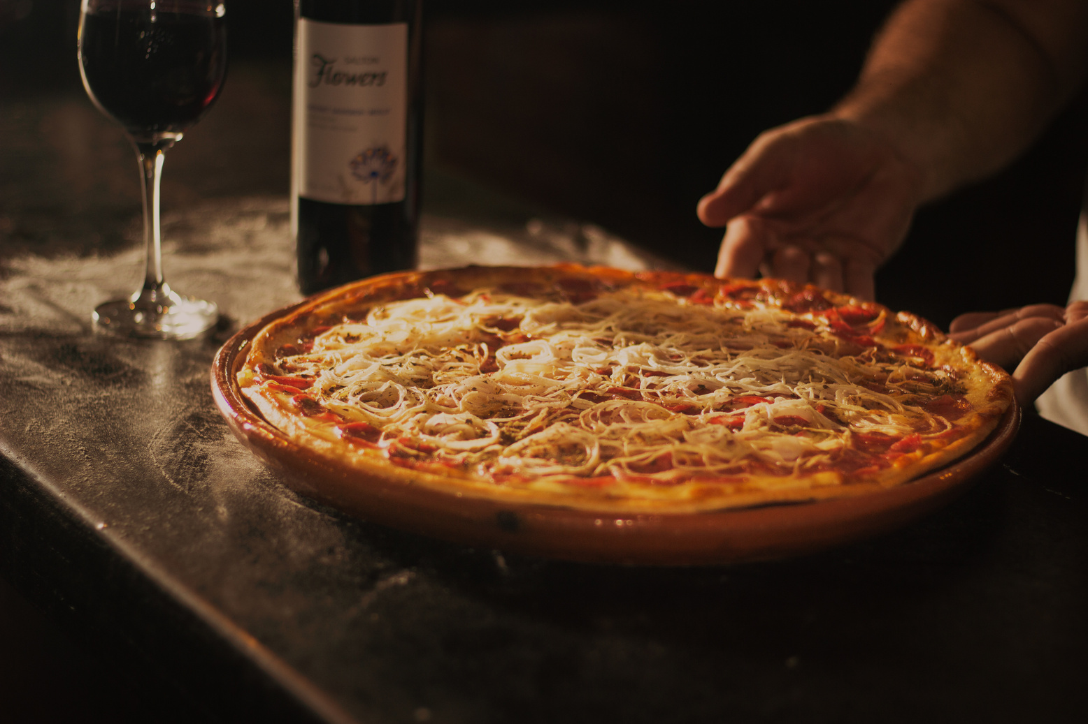
We have 4 tables is given below
select * from order_details;
select * from orders;
select * from pizza_types;
select * from pizzas

Slide 3
Basic Query
1 - Retrieve the total number of orders placed.
2 - Calculate the total revenue generated from pizza sales .
3 - Identify the highest-priced pizza.
4 - Identify the most common pizza size ordered.
5 - List the top 5 most ordered pizza types along with their quantities.

Slide 4
Intermediate Query
1 - Join the necessary tables to find the total quantity of each pizza category ordered.
2 - Determine the distribution of orders by hour of the day.
3 - Join relevant tables to find the category-wise distribution of pizzas.
4 - Group the orders by date and calculate the average number of pizzas ordered per day.
5 - Determine the top 3 most ordered pizza types based on revenue.

Slide 5
Advanced Query
1 - Calculate the percentage contribution of each pizza type to total revenue.
2 - Analyze the cumulative revenue generated over time.
3 - Determine the top 3 most ordered pizza types based on revenue for each pizza category.

Slide 6
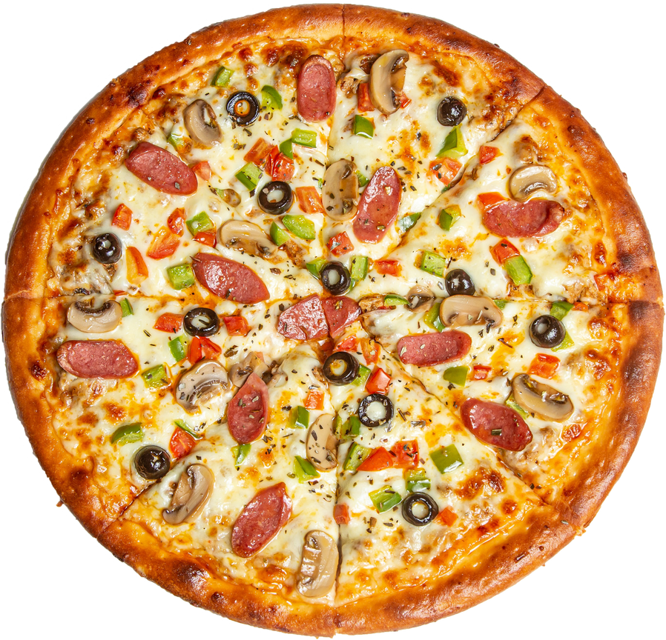
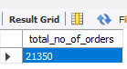
1 - Retrieve the total number of orders placed.
select
count(order_id) as total_no_of_orders from orders;
Order Now
21350

Slide 7
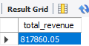
2 - Calculate the total revenue generated from pizza sales
select
round(sum(piz.price * od.quantity),2) as total_revenue
from order_details od inner join pizzas piz
on od.pizza_id = piz.pizza_id;
Total Revenue

Slide 8

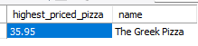
3 - Identify the highest priced pizza.
select piz.price as highest_priced_pizza, pty.name from pizzas piz inner join
pizza_types pty on
piz.pizza_type_id = pty.pizza_type_id
order by highest_priced_pizza desc limit 1;
The Greek Pizza
$35.95

Slide 9
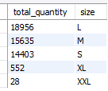
4 - Identify the most common pizza size ordered.
select sum(od.quantity) as total_quantity, piz.size
from pizzas piz
inner join order_details od on piz.pizza_id = od.pizza_id
group by piz.size
order by total_quantity desc;

Slide 10
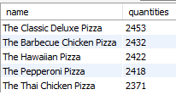
5 - List the top 5 most ordered pizza types along with their quantities.
select pty.name, sum(od.quantity) as quantities from pizza_types pty
inner join pizzas piz on pty.pizza_type_id = piz.pizza_type_id
inner join order_details od on piz.pizza_id = od.pizza_id
group by pty.name
order by quantities desc
limit 5;

Slide 11
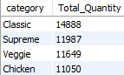
1 - Join the necessary tables to find the total quantity of each pizza category ordered.
select pt.category, sum(od.quantity) as Total_Quantity
from pizza_types pt
inner join pizzas piz on pt.pizza_type_id = piz.pizza_type_id
inner join order_details od on piz.pizza_id = od.pizza_id
group by pt.category
order by Total_Quantity desc;

Slide 12
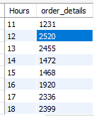
2 - Determine the distribution of orders by hour of the day.
select hour(time) as Hours, count(order_id) as order_details from orders
group by Hours;

Slide 13
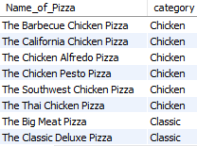

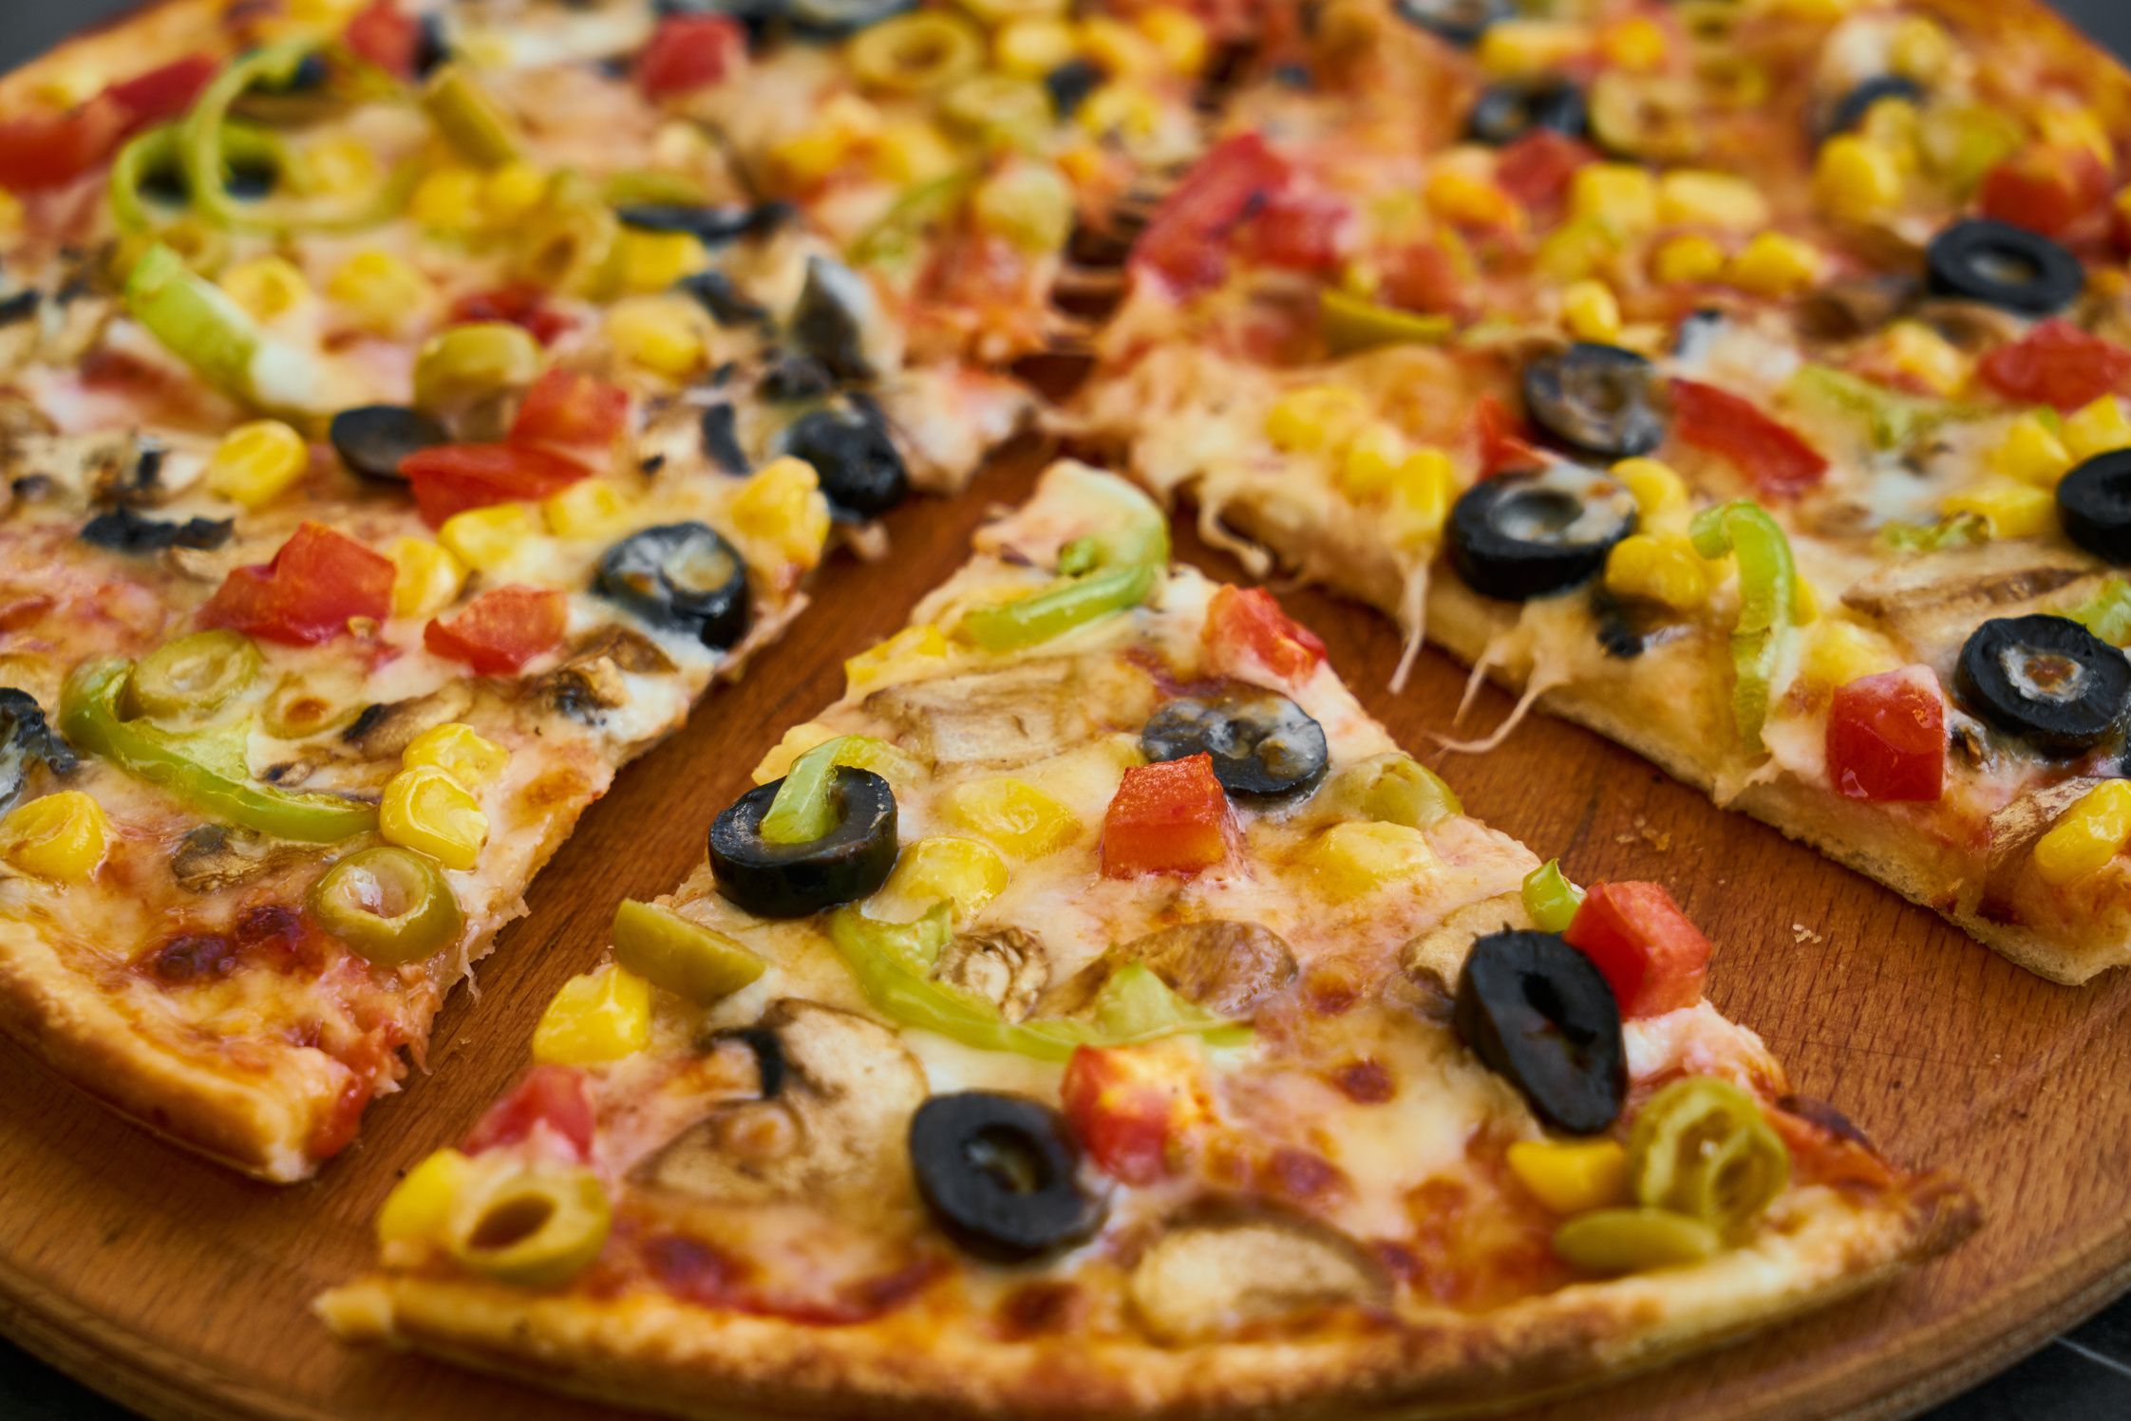

3 - Join relevant tables to find the category-wise distribution of pizzas.
select distinct(N
ame) as Name_of_Pizza, category from pizza_types;

Slide 14
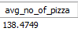
4 - Group the orders by date and calculate the average number of pizzas ordered per day.
select avg(no_of_pizza) as avg_no_of_pizza from
(select day(o.date), sum(od.quantity) as no_of_pizza from orders o
inner join order_details od
on
od.order_id = o.order_id
group by o.date) as order_quantity;

Slide 15
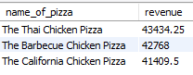
5 - Determine the top 3 most ordered pizza types based on revenue.
select (pty.name) as name_of_pizza, round(sum(piz.price * od.quantity),2) as revenue from pizzas piz
inner join order_details od on piz.pizza_id = od.pizza_id
inner join pizza_types pty on piz.pizza_type_id = pty.pizza_type_id
group by name_of_pizza
order by revenue desc
limit 3;

Slide 16
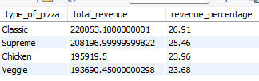
1 - Calculate the percentage contribution of each pizza type to total revenue.
SELECT
pty.category AS type_of_pizza,
SUM(piz.price * od.quantity) AS total_revenue,
ROUND((SUM(piz.price * od.quantity) /
(SELECT SUM(piz.price * od.quantity)
FROM pizzas piz
INNER JOIN order_details od ON piz.pizza_id = od.pizza_id)
) * 100, 2) AS revenue_percentage
FROM pizzas piz
INNER JOIN order_details od ON piz.pizza_id = od.pizza_id
INNER JOIN pizza_types pty ON piz.pizza_type_id = pty.pizza_type_id
GROUP BY pty.category
ORDER BY total_revenue DESC;

Slide 17
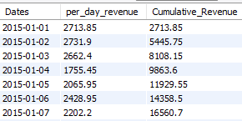
2 - Analyze the cumulative revenue generated over time.
select Dates, per_day_revenue,
sum(per_day_revenue) OVER (order by Dates) as Cumulative_Revenue
from
(select (o.date) as Dates, round(sum(piz.price * od.quantity),2) as per_day_revenue from pizzas piz
inner join order_details od on piz.pizza_id = od.pizza_id
inner join orders o on o.order_id = od.order_id
group by Dates) as sales_per_day;

Slide 18
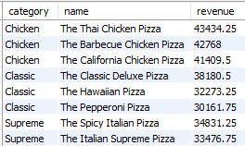
3 - Determine the top 3 most ordered pizza types based on revenue for each pizza category.
select category, name, revenue from
(select category, name, revenue,
rank() over( partition by category order by revenue desc) as rn
from (select pt.name, pt.category, round(sum(piz.price * od.quantity),2) as revenue from pizza_types pt inner join pizzas piz on pt.pizza_type_id = piz.pizza_type_id inner join order_details od on
piz.pizza_id = od.pizza_id
group by pt.name, pt.category) as a) as b
where rn <= 3;

Slide 19
Pizza Resto Presentation
THANK YOU
FOR ATTENTION
See You Next
www.reallygreatsite.com

